Slide 1
Activity 03: Modeling & Forecasting
SISMID Lab
July 22 through July 24, 2026
A Human-AI Teaming Approach to Infectious Disease Modeling

Slide 2
Lecture Overview
Topic | Slides
1. General Housekeeping | 3
2. Lab Timeline | 4
3. Task Overviews | 5
4. Goal Output | 6
5. Joint Instructor and Class Exercise | 7
6. Task 0: Set-Up | 8–11
7. Task 1: Training and Forecast Period | 12–16
8. Task 2: Baseline Model Specification | 17–22
9. Task 3: Forecasting | 23–42
10. Task 4: Visualization | 43–47
11. Task 5: Extensions | 48–61

Slide 3

General Housekeeping
Any slide with this icon contains the overview and
expected outputs for the included tasks. All outputs listed on these slides should be uploaded to the course GitHub repository for review.
Any slide with this icon indicates that it is time to complete a hands-on activity. Carefully follow the instructions provided, complete the required task, and verify your results.

Slide 4
Lab Timeline
We are here
Activity 1
Activity 2
Activity 3
Activity 4
Data Cleaning &
Visuals
Data
Exploration
Modeling & Forecasting
Evaluation
Activity 5 Refinement

Slide 5
Task Overviews
Task | Description
Task 0: Set-Up | Set up the environment and load and validate the input data.
Task 1: Specifying the Training and Forecast Period | Define the training and testing periods and set up an expanding window so each forecast trains on all data available up to that week.
Task 2: Baseline Model Specification | Specify a baseline ARIMA (Auto Regressive Integrated Moving Average) model and write the model specification rules for the AI to follow.
Task 3: Forecasting | Generate forecasts from the reference date and target end dates, extract the median and 95% prediction interval bounds, and prepare the output in FluSight format.
Task 4: Visualization | Visualize the forecast results and write the visualization rules that define how the plots should look.
Task 5: Extensions | Expand to the full FluSight format by adding the 2- and 3-week-ahead forecasts and iterating on the prompt.

Slide 6
Goal Output
From this activity you should produce two outputs: a FluSight-format forecast file and a forecast figure. An AI agent generates them from the cleaned weekly admissions data, guided by the rules you write in rules.md.
Activity Output | Description
flusight_forecasts.csv | A FluSight-format forecast file with 1-, 2-, and 3-week-ahead quantile forecasts (median and prediction interval bounds) for U.S. influenza admissions.
forecast_vs_observed.png | A plot of the forecast showing the median and 95% prediction interval against the observed weekly admissions data.

Slide 7
A Joint Instructor and Class Exercise
We tackle the prompts together, live. Then, we will trade ideas back and forth, refining the rules until the AI produces what we want.
Instructor
Class
Prompt and Demo
Poses a prompt, works through it live, and thinks out loud.
Suggests rules, asks questions, and points out what to fix.
Ideas and Questions
We keep this back and forth going until the output looks right, then you try it on your own.

Slide 8
Task 0: Set-Up

Slide 9
# Forecasting
We first need to put rule(s) in place to create and save the R script. As this is an important piece to set-up the rest of what we will do for this activity, this code will sit at the very top of our rules. Add this rule under the # Forecasting header:
Save all code in this section to the following output script:
**Output folder:** `output/scripts/03_forecast.R`
The output folder may not yet exist in your working directory; we can put a rule in place to guard against this:
If the folder pathway is not present, create the folder pathway prior to saving the script.

Slide 10
## 1. Input Data
Next, we need to provide details related to what data we want to work with throughout the script (i.e., data we created in the previous activities).
To do so, all we need to do is give the AI the file path to the data. This ensures that the exact file we want is used as the remainder of the script is created.
First, add the 1. Input Data header under # Forecasting. Then, copy over the following rule:
Read in the input data set from `output/data/01_cleaning/cleaned_flu_admissions.csv`.

Slide 11
Input Data Validations
AI is not perfect by any means, so we want to build in some validations and error messages to help us catch any mistakes that might occur (e.g., file structure, parsing issues, etc.).
Under the input rule, include the following validations rules:
Ensure the column names and column types/formats match the following:
- `week`: Date column, YYYY-MM-DD
- `location`: Character; all values should be "US"
- `value`: Numeric
If any columns have violations please first try to parse to the correct format, and then notify the user. If any columns can not be parsed, please return the following error:
'The {column} could not be parsed.'

Slide 12
Task 1: Specifying the Training and Forecast Period

Slide 13
The Plan: Training & Testing Periods
TRAINING PERIOD
Seasons before 2025-2026
Fit the model on all observed weeks strictly before the first week of the testing period present in the data. Use these rows as the fixed initial training set; subsequent forecasts will use an ‘expanding window’.
TESTING PERIOD (Rolling)
2025-2026 Season
Use the defined 2025-2026 season (See Previous Slides) as the testing period.
Forecasting Horizon: 1-Week Ahead (horizon = 1)

Slide 14
Expanding Window
Forecasts are produced with an expanding window. For each target week in the testing period, the model is refit on all observed weeks that fall strictly before that target week. The initial training data is the set of weeks strictly before the first testing-week present in the data; as each test week becomes observed it is added to the fitting window for subsequent targets.

Slide 15
Adding in Diagnostics (a.k.a. Checks)
As we build this out, it's important that we include code checks along the way to ensure that things we specified in the rules.md are being interpreted by the AI as we intended.
Some Examples:
**Validations:** Print the `Training Period` start date and rolling window end dates.
**Validations:** Print the `Testing Period` start date, and each forecast date.
**Validations:** Print the specified forecasting horizon that will be used.

Slide 16
Now it’s your turn!
We will work through the following steps together to add the next section to our rules.md document.
1
Create the ## 3. Training and Testing Periods section header in rules.md.
Write detailed rules to specify the training and testing period information; including the ‘expanding window’ set up (we will do this together).
2
3
Regenerate agents.md from your updated rules document
4
Use the agents.md file and Copilot (or your preferred AI) to generate output/scripts/03_forecast.R. Run the script and check the output.

Slide 17
Task 2: Baseline Model Specification

Slide 18
Auto Regressive Integrated Moving Average (ARIMA)
A group of models that uses a time series' past values and past forecast errors to explain the current values of the series, with the goal of producing forecasts.
AR Model (p)
Uses the series' own recent values to predict what comes next
Integrated (d)
Used to make the time series stationary (stable over time), by subtracting the previous observation from the current one
MA Model (q)
Uses its own recent misses (how far off past predictions were) to predict what comes next
Assumes: The series is stationary after differencing (stable mean and variance over time).

Slide 19
Model Specification Rules

Slide 20
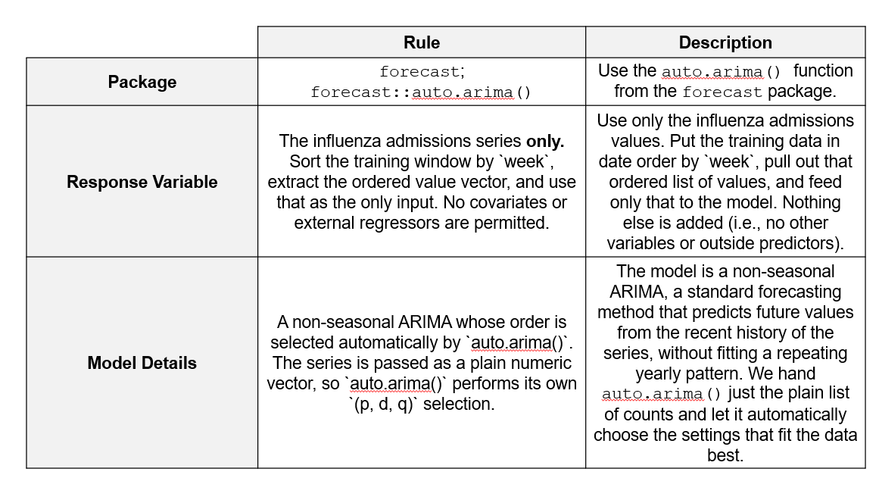
Rules for Model Specification

Slide 21
Adding in Diagnostics (a.k.a. Checks)
As we build this out, it's important that we include code checks along the way to ensure that things we specified in the rules.md are being interpreted by the AI as we intended.
Some Examples:
**Validations:** Print confirmation that the training window is sorted ascending by `week` with no missing or duplicate weeks.
**Validations:** Print confirmation that the `week` index is evenly spaced (no skipped weeks); halt if this fails.
**Validations:** Print the `(p, d, q)` order that `auto.arima()` selected at each refit step.

Slide 22
Now it’s your turn!
We will work through the following steps together to add the next section to our rules.md document.
1
Create the ## 4. Model Specification section header in rules.md.
Write detailed rules to fit the model using the expanding window approach and put the checks into place (we will do this together).
2
3
Regenerate agents.md from your updated rules document
4
Use the agents.md file and Copilot (or your preferred AI) to generate output/scripts/03_forecast.R. Run the script and check the output.

Slide 23
Task 3: Forecasting

Slide 24
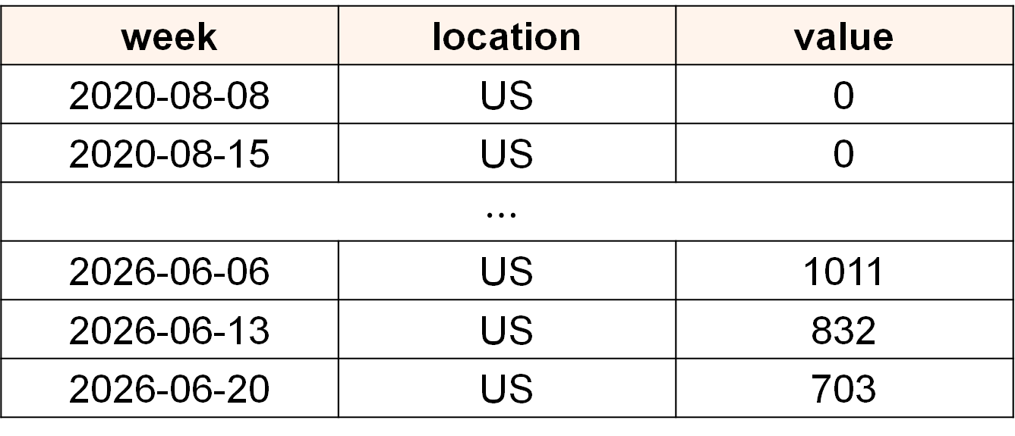
What does our data look like?
week | location | value
2020-08-08 | US | 0
2020-08-15 | US | 0
$$⋯$$
2026-06-06 | US | 1011
2026-06-13 | US | 832
2026-06-20 | US | 703
What are our reference dates (i.e., cut off for input data) and what are our target end dates (i.e., forecast dates)?

Slide 25
Reference Dates
Reference dates are the last week of observed data we include in our training period (i.e., model input). A week is defined as Sunday to Saturday, with the Saturday used for the label.
For example, if our most recent data is the week of 2026-06-20, that's our reference date, and we forecast the next week from it.
Observed Data
Horizon 1
2026-06-27
Horizon 2
2026-07-04
Horizon 3
2026-07-11
Reference Date
2026-06-20

Slide 26
Target End Dates
Target end dates are the weeks we are producing forecasts for. A week is defined as Sunday to Saturday, with the Saturday used for the label.
For example, if our reference date is 2026-06-20, our target end dates are 2026-06-27, 2026-07-04, and 2026-07-11 (the 1-, 2-, and 3-week-ahead forecasts).
Observed Data
Horizon 1
2026-06-27
Horizon 2
2026-07-04
Horizon 3
2026-07-11
Reference Date
2026-06-20
Target End Dates

Slide 27
Things to Consider
How do we calculate our reference date?
Hint: Compute the reference date as the calendar date exactly one week before the target date: reference_date = as_date(t) - days(7).
Where do we want to use the reference date specification?
Hint: Use this date (reference_date) for both training-window selection and for output.
How do we want to explicitly format our dates in the output?
Hint: When writing CSVs, format reference_date and target_end_date as ISO dates (`YYYY-MM-DD`).
Be explicit about dates. R can handle dates unpredictably; by being explicit we can stop issues and unexpected behavior before they happen.

Slide 28
Adding in Diagnostics (a.k.a. Checks)
Some Examples:
**Validations:** Print confirmation that reference_date and the target t are both Date objects (not character or POSIXct); halt if either fails the class check.
**Validations:** Print confirmation that target_end_date - reference_date equals exactly 7 days for every row; halt if this fails.
**Validations:** Print confirmation that the maximum week in the training window is <= reference_date and strictly less than the target_end_date (no look-ahead leakage); halt if this fails.

Slide 29
Now it’s your turn!
Together, we will update the rules to include the date formatting requirements discussed on the previous slide (contains hints related to formatting).
1
Create the ## 5. Forecast Generation section header in rules.md and add the statement For each target week `t` in the testing period that is present in the data: under it.
Write detailed rules to specify how to handle dates in list item one (i.e., under the statement from Step 1; add 1. and your rules). As part of this step, add in validation checks.
2
3
Regenerate agents.md from your updated rules document.
4
Use the agents.md file and Copilot (or your preferred AI) to re-generate output/scripts/03_forecast.R. Run the script and check the output.

Slide 30
We have our date rules, now what?
Data leakage happens when a model is tested on data used in training (i.e., it "predicts" values it was handed, so the forecast is better than it would be in practice when you don’t actually see the data).
To prevent this, we're explicit about the cutoff: only data on or before the reference date goes in as input, so the model never sees the weeks it's forecasting.
Add the following under the date rule(s):
2. Fit the ARIMA model (Rule 4) on all rows with `week <= reference_date` (expanding-window).

Slide 31
Why include the data leakage rule again? AI assistants can be forgetful. When we ask the AI to generate a new section of code, it does not always carry forward the constraints we set earlier, so an important rule can quietly get dropped. The cutoff, using only data on or before the reference date, is what keeps the forecast honest, so we restate it right where the forecasts are generated. That keeps it front and center for the AI and guards against the model training on the very weeks it is supposed to predict, which would make the forecast look better than it really would be in practice.

Slide 32
Forecasting (1-Week Ahead)
output_type | output_type_id | value | Description
quantile | 0.025 | # | Lower Bound (95% PI)
quantile | 0.5 | # | Median
quantile | 0.975 | # | Upper Bound (95% PI)
How do we get the values?
3. Forecast with `forecast(fit, h = 1, level = 95)`.

Slide 33
Extracting the Median & 95% PI Bounds
forecast(fit, h = 1, level = 95)
Lower Bound
(fcst$lower)
Point Forecast
(fcst$mean)
Upper Bound
(fcst$upper)
Things to think about when writing rules.
What pieces of information do we need to extract from the forecast call? What format will the data come back in (Hint: The lower and upper bounds come back with one column per level)? Are there any restrictions we want to place on the results (Hint: Rounding, Truncating at 0)?

Slide 34
Adding in Diagnostics (a.k.a. Checks)
Some Examples:
**Validations:** Confirm mean, lower, and upper are all finite (no NA/NaN/Inf) at each forecast step; halt if not.
**Validations:** Confirm the values for each quantile are non-decreasing (ex. value for 0.025 ≤ 0.5 ≤ 0.975) within every target week. Halt on any violation.
**Validations:** Confirm all value entries are non-negative integers.

Slide 35
Now it’s your turn!
Together, we will add a rule for extracting the median and 95% PI Bounds. Pay particular attention to the hints provided on the previous slide.
Using the hints from the previous slide, write the rule (not the code) for extracting the median and 95% PI bounds from the forecast function (Rule 4). Make sure to include a statement about the output structure, any rules about results, and code checks (Hint: See previous slides).
1
2
Regenerate agents.md and Use the agents.md file and Copilot (or your preferred AI) to re-generate output/scripts/03_forecast.R. Run the script and check the output.
Note: In a few places we hand the AI an exact function or code snippet. This does not defeat the purpose of AI-assisted coding. When I already know a function that works well for the task, naming it points the AI to the right approach instead of leaving it to guess, and the AI still writes and connects the surrounding code. Bringing that kind of domain knowledge is the human side of the human-AI team.

Slide 36
Preparing File in FluSight Format
What is the FluSight format?

Slide 37
Column | Description | Entry Type | Acceptable Values
reference_date | The last day of the week the forecast(s) are submitted to the challenge. It is the Saturday following the forecast due date. | ISO Format Date | YYYY-MM-DD
target | The target of the forecast. | Character | wk inc flu hosp
horizon | The number of weeks between the reference_date and the target_end_date. | Numeric | [1]
target_end_date | The last date of the retrospective/nowcast/ forecast target’s week (Saturday). | ISO Format Date | YYYY-MM-DD
location | FIPS codes for U.S. states as well as "US" for national forecasts the corresponding row is associated with. | Character | US
output_type | The type of value shown. | Character | quantile
output_type_id | The quantile label for the value in the corresponding row. | Numeric | 0.01, 0.025, 0.05, 0.1, 0.15, 0.2, 0.25, 0.3, 0.35, 0.4, 0.45, 0.5, 0.55, 0.6, 0.65, 0.7, 0.75, 0.8, 0.85, 0.9, 0.95, 0.975, and 0.99
value | The non-negative numbers indicating the quantile prediction for the corresponding row. | Numeric | Integer

Slide 38
First, Handling the Quantiles (Wide-to-Long)
Our Current Format
0.025 | 0.5 | 0.975
VALUE | VALUE | VALUE
Our Goal Format
output_type_id | value
0.025 | #
0.5 | #
0.975 | #

Slide 39
How do we get there?
Add the following (Including the table):
4. **Reshape wide → long, one row per quantile.** Map each forecast piece to an `output_type_id`: `mean` → `0.5` (median); each level's lower/upper bound → its two quantiles, per the table. Only include the levels below.
Coverage Level | LB Quantile (`output_type_id`) | UB Quantile (`output_type_id`)
95 | 0.025 | 0.975

Slide 40
Why do we need the table?
forecast() and FluSight describe the same thing in two different languages. When you ask for a "95% interval," forecast() gives you a lower and an upper edge — those edges are the 0.025 and 0.975 quantiles that FluSight asks for. Think of the table as your & the AI’s translation guide between the two.
Hint (for later): Want more quantiles? Update two things together — add a row here (table) and set level in the forecast call to match. After that, everything downstream follows automatically.

Slide 41
Column | Description | Entry Type | Acceptable Values
reference_date | The last day of the week the forecast(s) are submitted to the challenge. It is the Saturday following the forecast due date. | ISO Format Date | YYYY-MM-DD
target | The target of the forecast. | Character | wk inc flu hosp
horizon | The number of weeks between the reference_date and the target_end_date. | Numeric | [1]
target_end_date | The last date of the retrospective/nowcast/ forecast target’s week (Saturday). | ISO Format Date | YYYY-MM-DD
location | FIPS codes for U.S. states as well as "US" for national forecasts the corresponding row is associated with. | Character | US
output_type | The type of value shown. | Character | quantile
output_type_id | The quantile label for the value in the corresponding row. | Numeric | 0.01, 0.025, 0.05, 0.1, 0.15, 0.2, 0.25, 0.3, 0.35, 0.4, 0.45, 0.5, 0.55, 0.6, 0.65, 0.7, 0.75, 0.8, 0.85, 0.9, 0.95, 0.975, and 0.99
value | The non-negative numbers indicating the quantile prediction for the corresponding row. | Numeric | Integer
We’ve gotten the output_type_id and value ready (previous slides), now we need to pull everything together into one data set!

Slide 42
Now it’s your turn!
On your own, add the rules for formatting the forecast in FluSight format and saving the file (Hint: look at the column names and descriptions provided on the previous slide).
1
Using a table format (see Reshape wide slide), create a table with the Column names and Type/Value for each field required for FluSight. Include this table as part of Rule 5. Use the table on the previous slide to guide you.
Save the file to output/data/03_forecast/flusight_forecasts.csv; create the folder if it is absent.
2
3
Regenerate agents.md from your updated rules document and use the agents.md file and Copilot (or your preferred AI) to re-generate output/scripts/03_forecast.R. Run the script and check the output.

Slide 43
Task 4: Visualization

Slide 44
Visualizing our Results
As a final step, we will visualize our results. A quick plot lets us catch any immediate issues (misaligned dates, wildly wide intervals, forecasts that ignore the trend) and get a feel for overall performance.
Remember, the rules for figures should be specific enough that someone (or an AI) could produce the plot without asking any follow-up questions.
We'll work together to build our final figure.

Slide 45
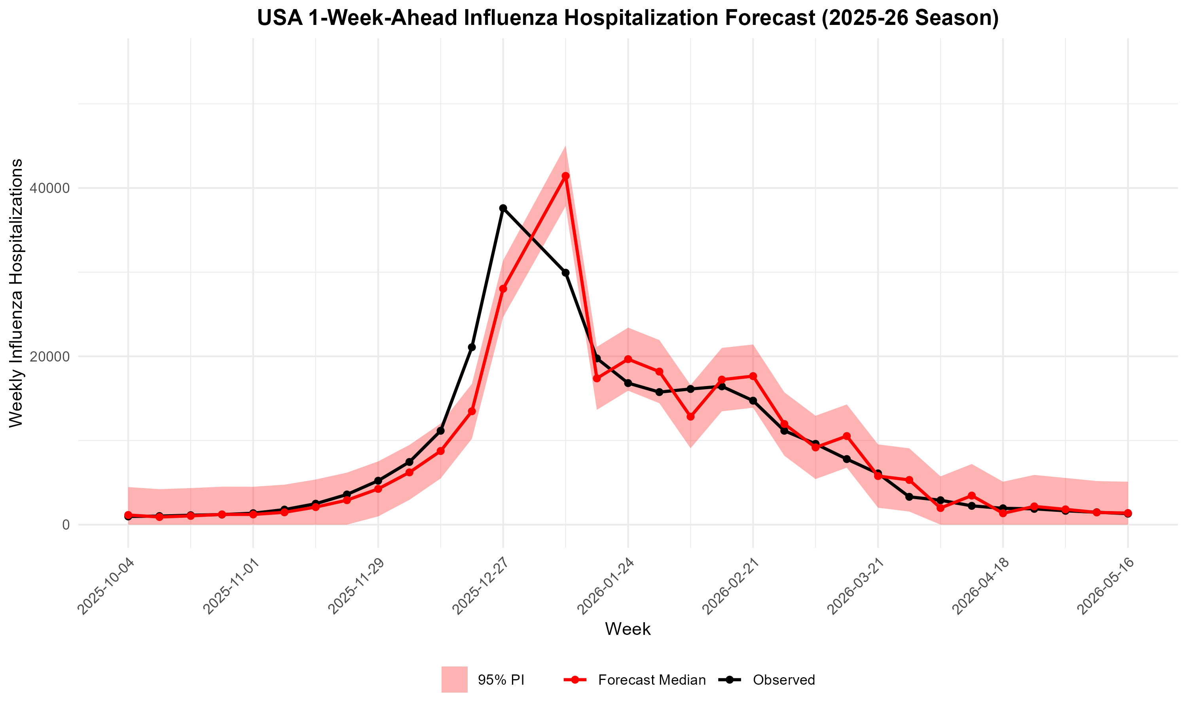

Slide 46
Writing the Visualization Rules
Things to think about:
Element | Description
Plot type & Plot Elements | line chart, bar chart, scatter, etc.
X-Axis and Y-Axis | variable, label text, date format, start at zero?
Title | exact title text for the figure
Colors and highlights | line color, shading, annotation colors
Annotations and markers | peak markers, reference lines, text labels
Legend | Legend elements, labels, colors
Output file name | output/figures/03_forecast/forecast_vs_observed.png
Save Requirements | DPI

Slide 47
Now it’s your turn!
We will work through the following steps together to add that next section to our rules.md document.
1
Create the ## 6. Forecast Figure section header under
## 5. Forecast Generation section header in rules.md.
Write detailed rules to obtain the forecast visual. Make sure to specify plot types, axes, colors, annotations, file names, etc. (vague rules = vague output).
2
3
Regenerate agents.md from your updated rules document
4
Use the agents.md file and Copilot (or your preferred AI) to update output/scripts/03_forecast.R. Run the script and check the output.

Slide 48
Task 5: Extensions

Slide 49
Expanding to full FluSight Format
Our current forecasts do not capture all horizons and quantiles required by FluSight.
The remainder of this activity will focus on expanding our current framework to all 23 quantiles and forecasting horizons required by the challenge.
 | Current | Goal
Horizons | 1-Week | 1 Week - 3 Weeks
Quantiles | 0.025, 0.5, 0.975 | 0.01, 0.025, 0.05, 0.1, 0.15, 0.2, 0.25, 0.3, 0.35, 0.4, 0.45, 0.5, 0.55, 0.6, 0.65, 0.7, 0.75, 0.8, 0.85, 0.9, 0.95, 0.975, and 0.99

Slide 50
Adding the 2- and 3-Week Forecasts
We reference our horizon (1-week) in many places — across the rules document and throughout the code. Rather than manually updating each one, we can use AI to help.
There are two ways we can go about it: (1) Manually update the rules document or (2) Work with AI to update the rules document and subsequent code.
For this exercise, we will be using AI to help us update the rules to get exactly what we want.

Slide 51
Prompting & Things to Consider
We are a human-AI team, so we need to make sure we give the AI the domain instruction it needs to help us execute our updates.
First, let’s think about the different pieces of our forecasting system that incorporates our forecasting horizon specification:
Forecasting
Visualization
Data Formatting

Slide 52
Updating is Often Iterative
AI is NOT perfect and may return different results each time you run it. It often may take a bit of back-and-forth to get to the final product you desire.
For each iteration, make sure to check all changes the AI makes.
Prompt AI to update the script & run the script.
Prompt AI to update rules.md.
Prompt AI to update agents.md.
Check the results.
Check the results.
Check the results.

Slide 53
Adding in Diagnostics (a.k.a. Checks)
AI can make mistakes, so we need to make sure to stay in the loop!
**Validations:** Confirm intervals get wider (or stay equal) as the horizon grows: width at h=3 ≥ h=2 ≥ h=1. Print "[val] intervals widen with horizon: OK"; stop() otherwise.
**Validations:** Confirm target_end_date == reference_date + 7 * horizon for every row. Print "[val] target dates correct: OK"; stop() otherwise.
**Validations:** Confirm each reference date is fit once, with all three horizons taken from that single forecast. Print "[val] one fit, three horizons: OK"; stop() otherwise.

Slide 54
Writing the Prompt
We are going to work with AI to help us write the updated rules.
We want to make sure we are explicit about the changes we want and review ALL changes it suggests.
Remember, we need to ask for changes in all places where we specify the forecast horizons:
First Part of Prompt: Introducing the Ask
I want to extend my forecasting to include 1-, 2-, and 3-week forecasting horizons. Please update the rules document where we forecast, prepare the data file, and visualizations.

Slide 55
Writing the Prompt
Second Part of Prompt: Data Format
Please keep the flusight format for the data file.
Third Part of Prompt: Visualizations
For the visualizations, I want each horizon to have their own line like what we do currently for 1-week horizons. Make sure the colors are distinct, and the legend clearly includes all graph elements.

Slide 56
Writing the Prompt
Final Part of Prompt: Validations
Please also include the following data checks:
Validations: Confirm intervals get wider (or stay equal) as the horizon grows: width at h=3 ≥ h=2 ≥ h=1. Print "[val] intervals widen with horizon: OK"; stop() otherwise.
Validations: Confirm target_end_date == reference_date + 7 * horizon for every row. Print "[val] target dates correct: OK"; stop() otherwise.
Validations: Confirm each reference date is fit once, with all three horizons taken from that single forecast. Print "[val] one fit, three horizons: OK"; stop() otherwise.

Slide 57
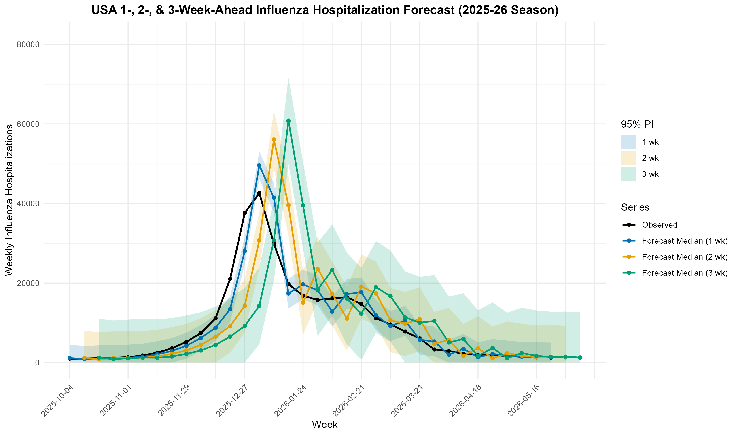

Slide 58
Updating the Quantiles
Now that we have updated our forecasting horizons, we now need to update our pipeline to capture all 23 quantiles
For this exercise, we will be using AI to help us update the rules to get exactly what we want.
 | Current | Goal
Quantiles | 0.025, 0.5, 0.975 | 0.01, 0.025, 0.05, 0.1, 0.15, 0.2, 0.25, 0.3, 0.35, 0.4, 0.45, 0.5, 0.55, 0.6, 0.65, 0.7, 0.75, 0.8, 0.85, 0.9, 0.95, 0.975, and 0.99

Slide 59
Writing the Prompt
We are going to work with AI to help us write the updated rules around adding additional quantiles.
We want to make sure we are explicit about the changes we want and review ALL changes it suggests.
Prompt: Updating the Quantiles
Now I want to update the quantiles we are forecasting. Please expand our forecasts and data files to capture the following quantiles (see attached). Please update the rules document to start.
Then, update the agents.md and 03_forecast.R.

Slide 60
Writing the Prompt
Final Part of Prompt: Validations
Please also include the following data checks:
Validations: For each reference date and horizon, confirm the quantiles are non-decreasing across every level: 0.01 ≤ 0.025 ≤ … ≤ 0.975 ≤ 0.99. Print "[val] quantiles non-decreasing: OK"; stop() otherwise.
Validations: Confirm every reference-date/horizon has the exact required set of quantile levels — none missing, none extra. Print "[val] all quantile levels present: OK"; stop() otherwise.
Validations: Confirm the median (0.5) equals the point forecast and symmetric pairs are equidistant from it (e.g. 0.025 and 0.975). Print "[val] median centered, quantiles symmetric: OK"; stop() otherwise.

Slide 61
